Slide 1

Deep Learning with Python
Chapter
5.3-5.5
Book Reading Group
Åke Edlund, Daniel Edsgärd

Slide 2
Session outline – 60 min
Quick summary of the week’s reading, 1-2 slides (5-10 min)
Group discussions (25 min)
See Groups (with place for changes) in Wiki
Discussing this week’s reading
Addressing N number of questions (assigned to the group)
Write your answers directly into the MS Teams Forms + update this ppt (see last slides)
Group presentations of answer slides (~5min/group)
Open discussion, all to particicpate
Summary, wrap up, next session (5 min)
Note: after session, we will update the wiki and files with above input.

Slide 3
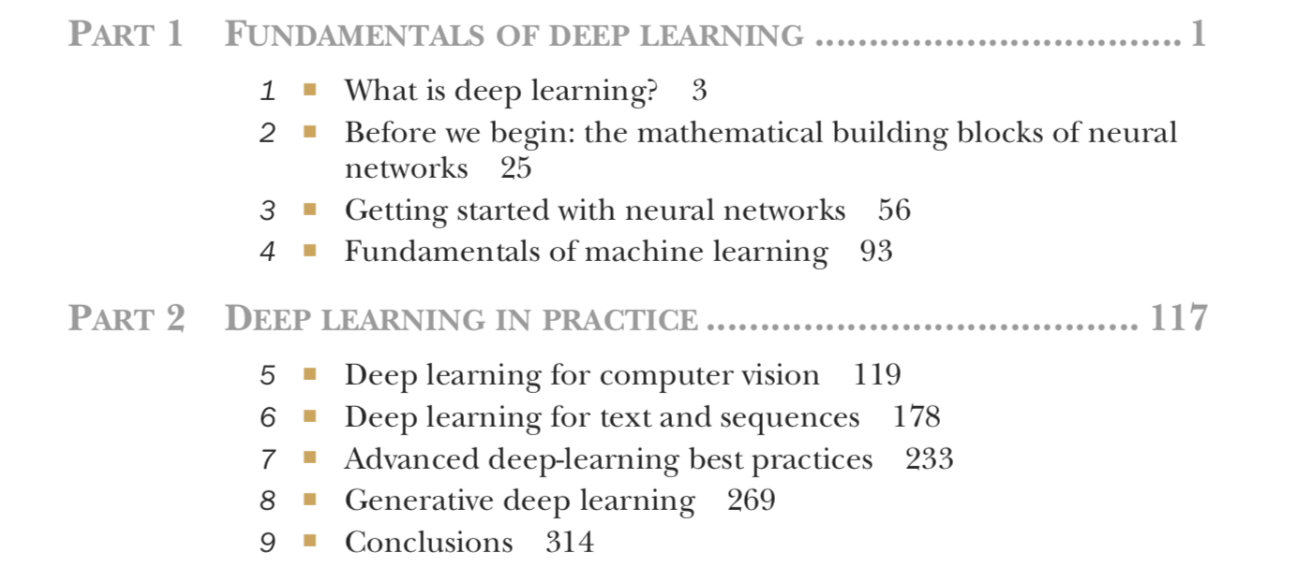
Timeplan
Sep 13 - Chapter 1-2
Sep 20 - Chapter 3
Sep 27 - Chapter 4
Oct 4 - Chapter 5.1-5.2
Oct 11 - Chapter 5.3-5.5
Oct 18 - Chapter 6.1-6.2
Oct 25 - Chapter 6.3-6.5
Nov 1 - Chapter 7
Nov 8 - Chapter 8.1-8.3
Nov 15 - Chapter 8.4-8.6
Nov 22 - Chapter 9

Slide 4
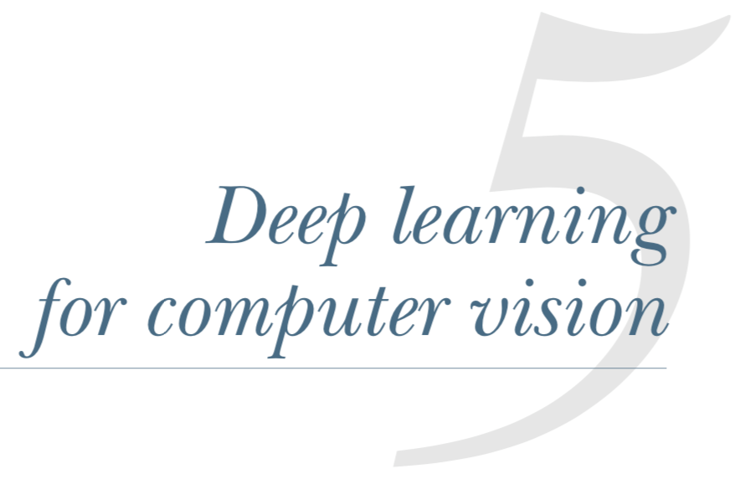
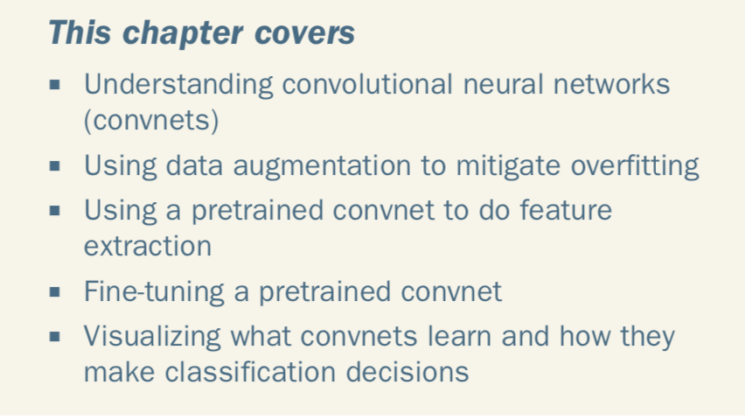
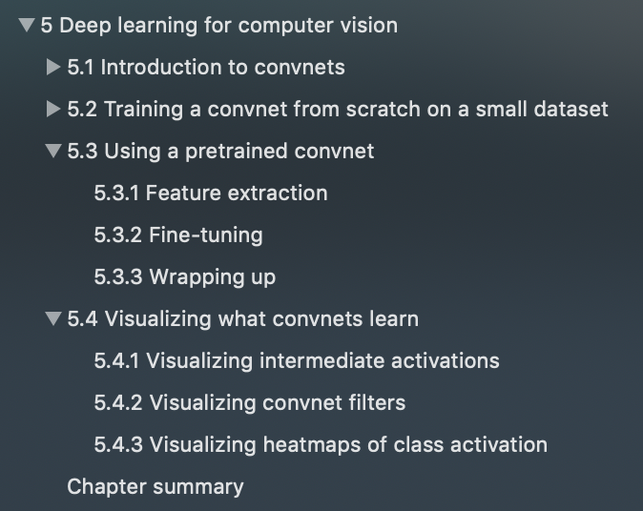

Slide 5
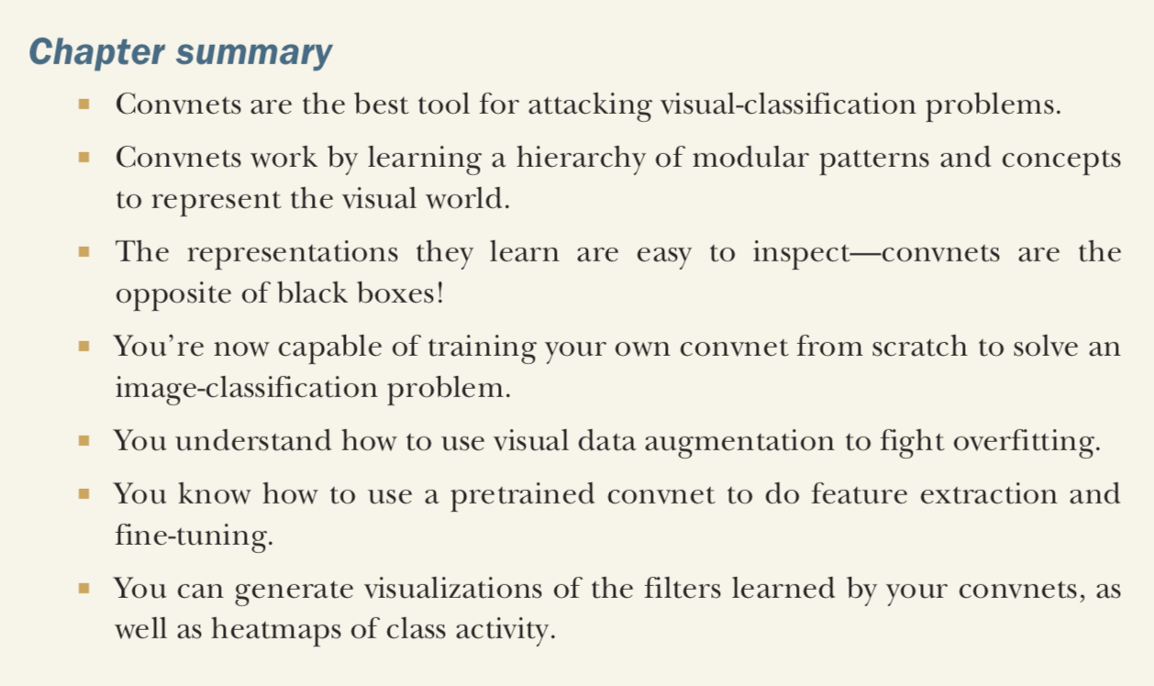

Slide 6
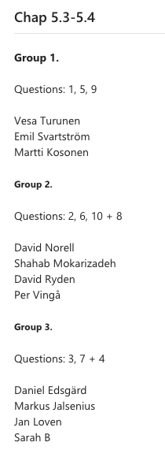

Slide 7
Group 1, Questions: 1, 5, 9
1. If we use the first option to reuse pre-trained model, why we can not use data augmentation together with fast feature extraction? (Shahab)
5. If you are using convnets for non-image-problems and non-image-input-data - what are the visualization techniques such as filter visualizations and heatmaps of class activation able to tell us? I.e., what are the applications and what is the relevance of such techniques in that setting? (David Norell)

Slide 8
Group 1, Questions: 1, 5, 9
9. I like the analogy where the filters can be viewed akin to Fourier basis functions. If one calculates the pairwise distances between the filter basis functions part of a layer (via the scalar product) couldn't that be used as a tool both to cluster the filters into separate types of filters that could help in interpretation as well as to help determine the number of channels of a layer? (Daniel Edsgärd)

Slide 9
Group 2, Questions: 2, 6, 8, 10
2. How far is "too far" between a pretrained convnet and the task att hand? If I want to classify e.g. boats from satelite images, the ImageNet intuitively seems quite useless to include. Are there any guidelines or best practice on choosing pretrained networks? (David R)
In regards to the question "how far is too far" it is very much an empirical question. In regards to "best practices" we googled and found a reasonable-sounding approach: "You always want to go for the smallest model that works well for your data. Up until earlier this year, people usually start with VGG16 or VGG19, but Resnet is also a great choice for fine tuning. Start with Resnet18, then to Resnet34 and Resnet50. You could also try the newer models in ResNext or Nascent nets." http://forums.fast.ai/t/how-to-pick-the-right-pretrained-model/8481
6. How to choose how many layers to fine-tune in pretrained convnet? Entire base is not recommended but where's the limit? (Vesa Turunen)
We guess it depends on the complexity of the pretrained convnet (number of layers etc), how much data you have available for training and the similarity between the different data sets and the type of problem trained

Slide 10
Group 2, Questions: 2, 6, 8, 10
10. I find it somewhat hard to follow the code notation describing the grad-CAM. If there is time, can you write the functions, with input and gradient, in a more compact mathematical notation? I guess the citation to the paper can help here. (Daniel Edsgärd)
This was a tough question, we need your support Daniel :-)
8. In the smoothed training performance curves, the author argues that the loss can increase while the accuracy increase due to that the average of the loss is calculated (p158). With that, I presume he means that the loss function is calculated as an average of the loss over all observations, such that for a smaller proportion of observations the loss is increasing a lot, while for the majority of observations the loss is decreasing? In that manner the total loss could increase while for the majority of observations it decreases. According to the def of the cross-entropy this should be able to happen. Does this also imply that one should look at the performance metric rather than the loss to decide the epoch to stop at? Is Keras's automated stops based on convergence of the loss or the performance metric? (Daniel Edsgärd)
We think default is loss for keras automated stops but it is possible to use for example other metrics specified by your own coding through using callback functionality according to these two links. https://github.com/keras-team/keras/issues/114 https://keras.io/callbacks/

Slide 11
Group 3, Questions: 3, 4, 7, 11
3. This is a bit like question 1, because I have a hard time actually seeing what the difference is between feature extraction with or without data augmentation. In the first case you take your dataset and run through the convnet as a sort of prediction, the features you get out you use as input to classification. In the second case you augment the dataset and run through convnet which you have frozen (i.e. as the case above).. and then add the classification. If you had put in data augmentation in your inputset in the first acse, wouldn't the 2 cases be the same? (Tonje)
Yes, we think so. One diff is that if you want have the convbase predictions stored with augmented then you also need to store the augmented perturbed.
7. A little bit like question 2. When using a pretrained network how general must it be to include the classes you you want to classify? Or can it be so that when trained on enough number of data the lower layers contains so many fine structures that it also gives a good result even when you are off by retraining the upper layers? (Jan Lovén)
* One idea would be to compare the lowest layers of pretrained networks such as Inception, Xception, VGG*, ResNet and start to see where they diff... * Could possibly look at what layers where certain filters are not activated in a pretrained network applying your dataset

Slide 12
Group 3, Questions: 3, 4, 7, 11
4. Looking at the convolutional base of the VGG16 model (e.g. p. 146), it seems like the pooling layers are interleaved with two to three consecutive convolutional layers. First, is it common to stack a few convolutional layers before pooling? Second, the output shape of a convolutional layer is identical to the input. In Section 5.1-5.2 we used a 3x3 convolutional window without padding, hence the output shape decreased after each convolutional layer. In the VGG16 model, what convolutional windows have been used? Can we assume that padding has been enabled? (Markus Jalsenius)
* Feature space is growing due to that the underlying window size is growing, covering larger parts of the input image. Therefore the variability of the data is larger and you need more layers to capture this. * We think one can see that padding is used from that the feature map has the same size between layers. One can then calculate window size from the number of params and given the number of channels.
11.

